Slide 1

Capstone Project 1
EDA on Hotel Booking Analysis
Prepared by: Data Miners team
Jasjot Kaur
Parul Saini
Venkatesh Ambore
Vineet Sharma

Slide 2
Problem Statement:
For this project we will be analyzing Hotel Booking data. This data set contains booking information for a city hotel and a resort hotel, and includes information such as when the booking was made, length of stay, the number of adults, children, and/or babies, and the number of available parking spaces.
Hotel industry is a very volatile industry and the bookings depends on above listed factors and many more.
The core objective behind this project is to understand and visualize dataset from hotel point of view; thereby analyzing it to discover important factors that govern the bookings. Hence provide insights to hotel management, which in turn will assist in making better strategies to reduce cancellations and perform various campaigns to boost their business and performance.

Slide 3
Work Flow:
We have divided our workflow into 3 steps as follows:
Data Collection & Understanding
Data Cleaning & Manipulation
Exploratory Data Analysis (EDA)
Exploratory Data Analysis or EDA is used to take insights from the data.
Data Scientists and Analysts try to find different patterns, relations, and anomalies in the data using some statistical graphs and other visualization techniques.

Slide 4
Steps involved in EDA:
1. Data Collection & Understanding
Data collection is the process of gathering and measuring information on variables of interest, in an established systematic fashion that enables one to answer stated research questions, test hypotheses, and evaluate outcomes for defining data (quantitative, qualitative).
Data understanding is the knowledge you have about data, the needs the data will satisfy.
Data collection and understanding of the project…
After collecting data it’s very important to understand it.
The Hotel Booking Analysis data contained 119390 rows and 32 columns. Let’s take a quick glance at these 32 columns.
hotel: Resort Hotel or City Hotel
is_canceled : Value indicating if the booking was canceled (1) or not (0)

Slide 5
lead_time : Number of days that elapsed between the entering date of the booking and the arrival date
arrival_date_year : Year of arrival date
arrival_date_month : Month of arrival date
arrival_date_week_number : Week number of year for arrival date
arrival_date_day_of_month : Day of arrival date
stays_in_weekend_nights : Number of weekend nights
stays_in_week_nights : Number of week nights.
adults : Number of adults
children : Number of children
babies : Number of babies
meal : Type of meal booked
country : Country of origin
market_segment : Market segment designation (TA/TO)
distribution_channel : Booking distribution channel (T/A/TO)
is_repeated_guest : is a repeated guest (1) or not (0)
previous_cancellations : Number of previous bookings that were cancelled by the customer prior to the current booking
previous_bookings_not_canceled : Number of previous bookings not cancelled by the customer prior to the current booking

Slide 6
reserved_room_type : Code of room type reserved
assigned_room_type : Code for the type of room assigned to the booking
booking_changes : Number of changes made to the booking from the moment of the booking until check-in or cancellation
deposit_type : No Deposit, Non Refund, Refundable
agent : ID of the travel agency that made the booking
company : ID of the company/entity that made the booking
days_in_waiting_list : Number of days the booking was in the waiting list before it was confirmed to the customer
customer_type : type of customer- contract, group, transient, transient party
adr : Average Daily Rate as defined by dividing the sum of all lodging transactions by the total number of staying nights
required_car_parking_spaces : Number of car parking spaces required by the customer
Total_of_special_requests : Number of special requests made by the customer (e.g. twin bed or high floor)
reservation_status : Reservation last status
reservation_status_date : Date at which the last status was made/updated.

Slide 7
2. Data Cleaning and Manipulation:
Data cleaning is the process of fixing or removing incorrect, corrupted, incorrectly formatted, duplicate, or incomplete data within a dataset.
When combining multiple data sources, there are many opportunities for data to be duplicated or mislabeled. If data is incorrect, outcomes and algorithms are unreliable, even though they may look correct.
The steps involved in data cleaning are as follows:
Step 1: Remove duplicate or irrelevant observations
In this step, all the null and duplicate values are removed,
The irrelevant null values are replaced with relevant data.
Step 2: Fix structural errors
The names of the columns are changed to fix structural errors.

Slide 8
Step 3: Round off integer values in data frame
For easier calculation of numeric data, we have rounded off the float dataset in various columns.
Step 4: Change data type as per requirement
The data type is changed for the sake of easier calculations and presentation.
Step 5: Adding new columns as per requirement
New columns are added as per our requirement using the existing columns.
Benefits of data cleaning
Having clean data will ultimately increase overall productivity and allow for the highest quality information in your decision-making. Benefits include:
Removal of errors when multiple sources of data are at play.
Ability to map the different functions and what your data is intended to do.
Monitoring errors and better reporting to see where errors are coming from, making it easier to fix incorrect or corrupt data for future applications.

Slide 9
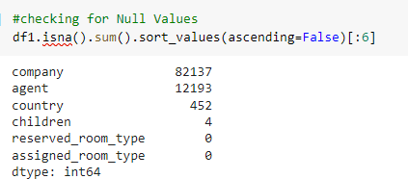
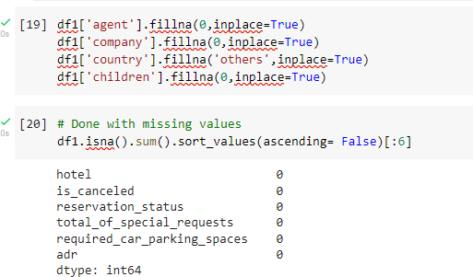
Data cleaning and manipulation in our project:
There were 4 columns with missing values, viz. company, agent, country and children

Slide 10
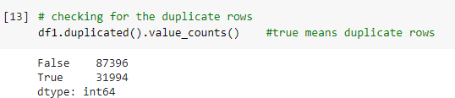

Handling Duplicates: Data had 31994 duplicates values. So we dropped it from the data.
Feature Engineering: We created 2 new columns :
‘Total_People’ = merging children, adults, babies
‘Total_stay’ = merging weekend nights and weekdays

Slide 11
3. Exploratory Data Analysis
Univariate analysis: In Univariate Analysis, you analyze data of just one variable. A variable in your dataset refers to a single feature/ column. You can do this either with graphical or non-graphical means by finding specific mathematical values in the data.
Bivariate analysis: Here, you use two variables and compare them. This way, you can find how one feature affects the other. It is done with scatter plots, which plot individual data points or correlation matrices that plot the correlation in hues.
Multivariate analysis: Here, you use three variables and compare them.

Slide 12
Data Visualization:
Data visualization is the representation of data through use of common graphics, such as charts, plots, info, graphics, and even animations. These visual displays of information communicate complex data relationships and data-driven insights in a way that is easy to understand.
Types of data visualizations:
Tables
Pie charts and bar charts
Scatter plots
Line graphs and area charts
Heat maps
Kdeplot

Slide 13
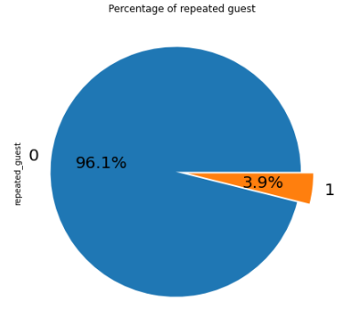
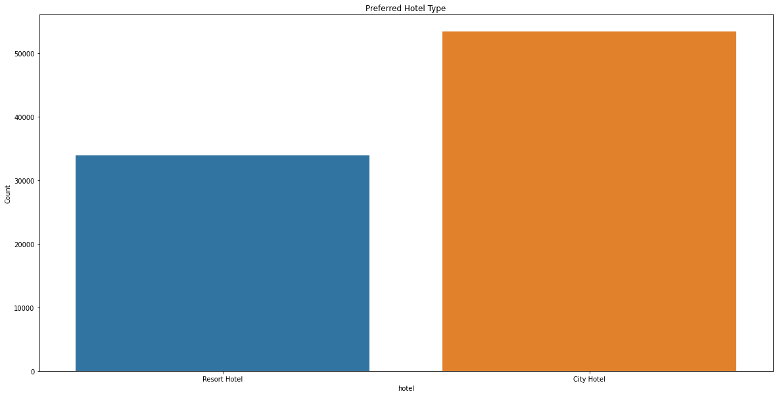
Exploratory Data Analysis:
Preferred Hotel Type % of Repeated Guests
Conclusions:
City hotel is the most preferred hotel type by the guests. We can say City hotel is the busiest hotel.
Only 3.9 % people were revisited the hotels. Rest 96.1 % were new guests. Thus retention rate is low.

Slide 14
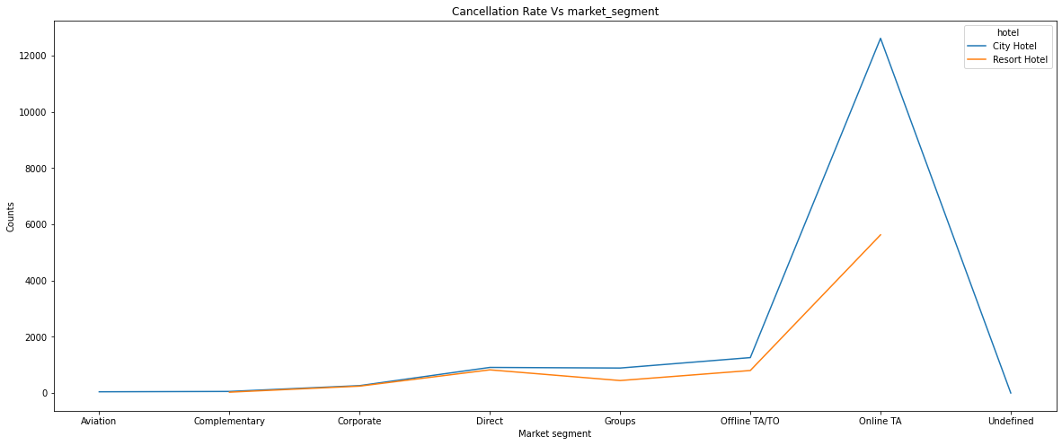
Exploratory Data Analysis:
Market Segment Cancellation Rate of each Hotel
to Meal & Agent
Conclusion:
Online TA among all the market Segment has the highest cancellation rate in both city and resort hotel.

Slide 15
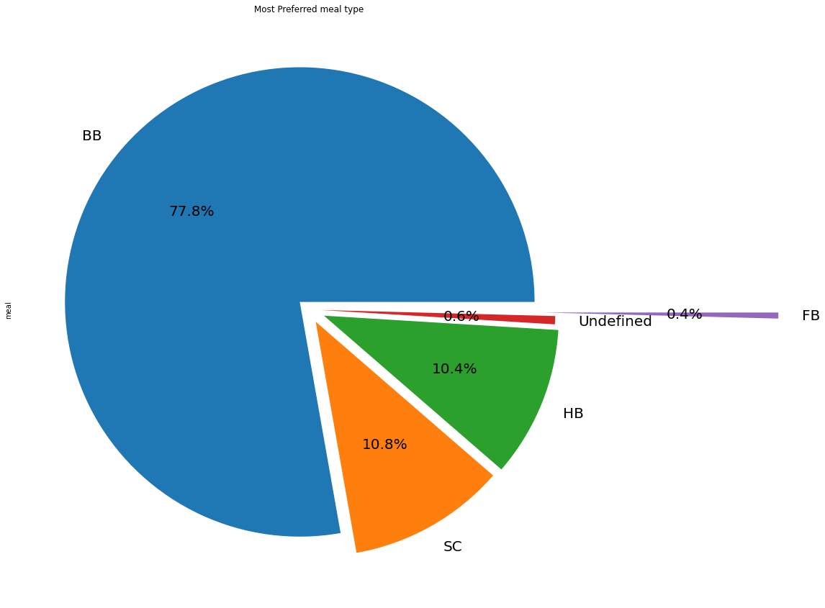
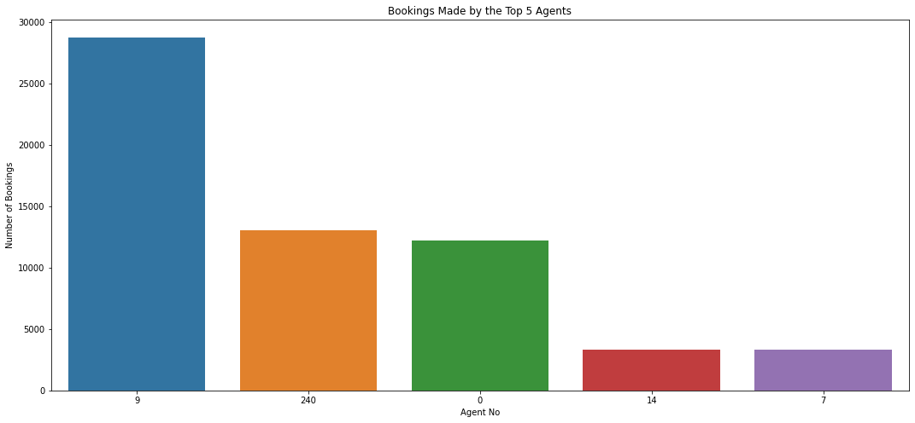
Exploratory Data Analysis:
Most Preferred Meal & Top 5 Agents
to Meal & Agent
Conclusions:
Bed and Breakfast (BB) is the most preferred meal type while Full Board i.e. FB is least preferred.
HB (Half Board) and SC(Self Catering) are equally preferred
The top 5 agents are: Agent 9, 240, 0, 14 and 7; among these Agent Id no -9 made the highest bookings (close to 29000).

Slide 16
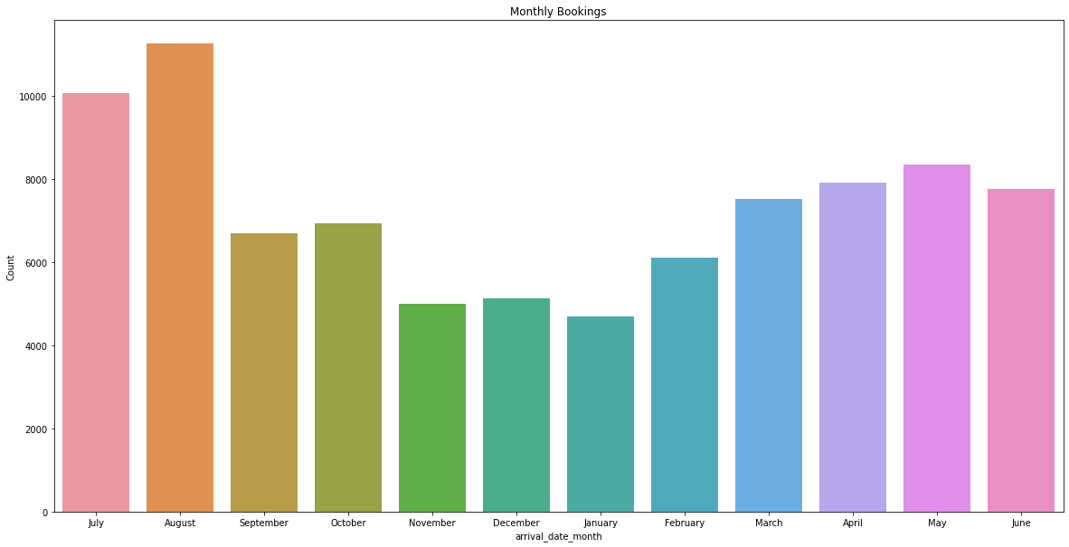
Exploratory Data Analysis:
Maximum Bookings Month
to Meal & Agent
Conclusions:
August month has the highest booking
January has the least number of booking

Slide 17
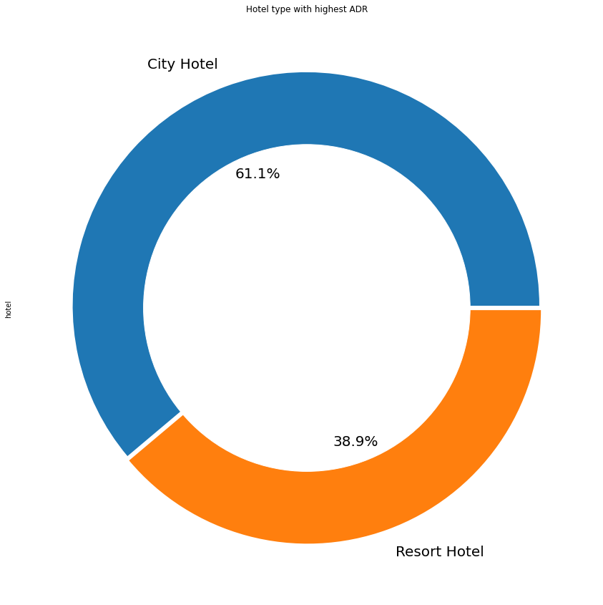
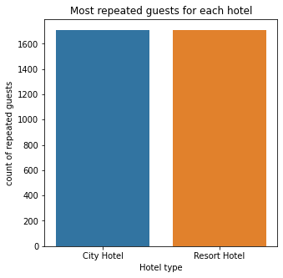
Exploratory Data Analysis:
Highest Rated Hotel and Repeatability of guests of each Hotel
to Meal & Agent
Conclusions:
City hotel has highest ADR, indicating more revenue earned by City hotel
As we can see in the our bar chart, almost same number of repeated guests are there for both the hotels. In order to get increase the count of repeated guests hotel management need to take the valuable feedbacks from the guests and try to give good service.

Slide 18
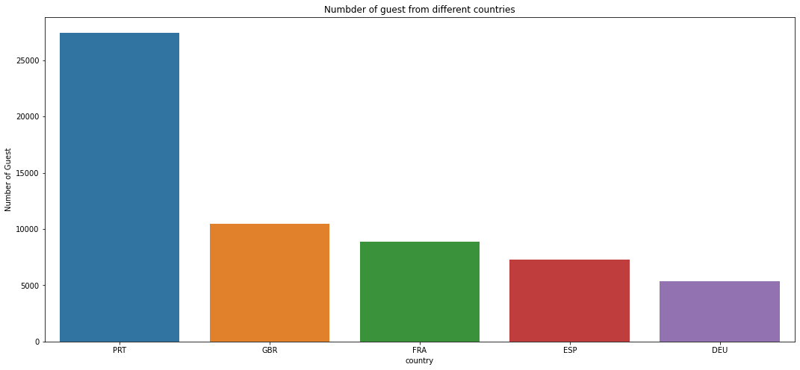
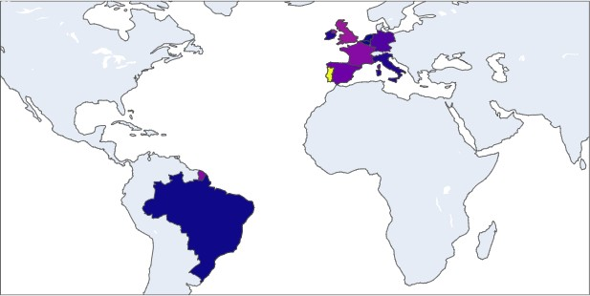
Exploratory Data Analysis:
Country having Maximum number of Guests
to Meal & Agent
Conclusions:
Portugal, Great Britain, France, Maximum number of guests were from Portugal (i.e. more than 25000 guests.
After Portugal, GBR(Great Britain), France and Spain are the countries from where most of the guests came.
Most of the bookings were for City hotels.

Slide 19
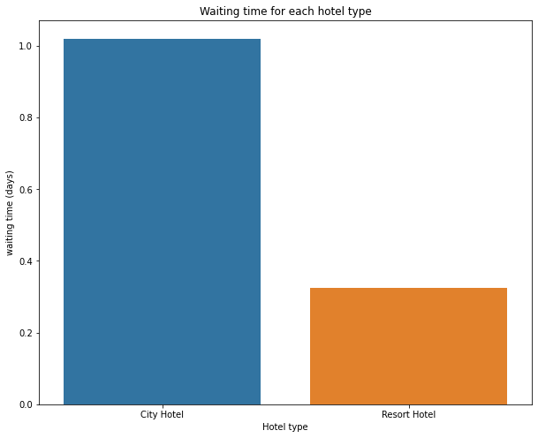
Exploratory Data Analysis:
Waiting Time of each Hotel type
to Meal & Agent
Conclusion:
Waiting time period refers to the number of days the booking was in the waiting list before it was confirmed to the customer
Waiting time period for City hotel is higher than resort hotels.
This indicates that either the city hotels are much busier than Resort hotel or there is low management in Resort hotels.

Slide 20
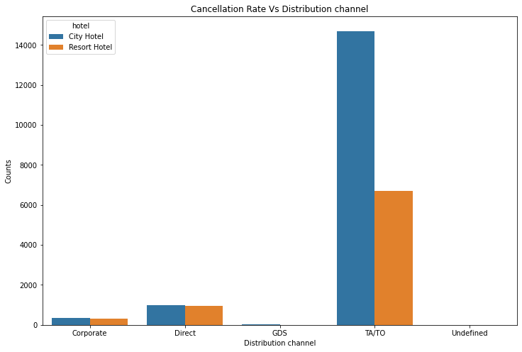
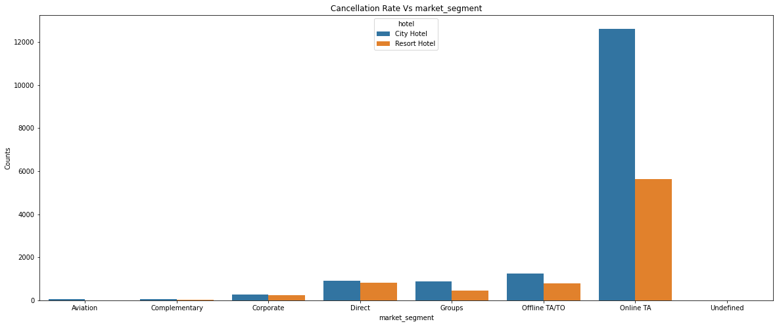
Exploratory Data Analysis:
Cancellation Rate Vs Distribution Channel and Market Segment of each Hotel
to Meal & Agent
Conclusions:
Distribution channel:
TA/TO’ distribution channel has highest cancellations for city hotels and more than 6000 cancellations for resort hotels. In order to reduce the cancellations they should improve their cancellation policies and deposit policies
Market Segment:
Online TA/TO’ market segment has highest cancellations for city hotels.

Slide 21
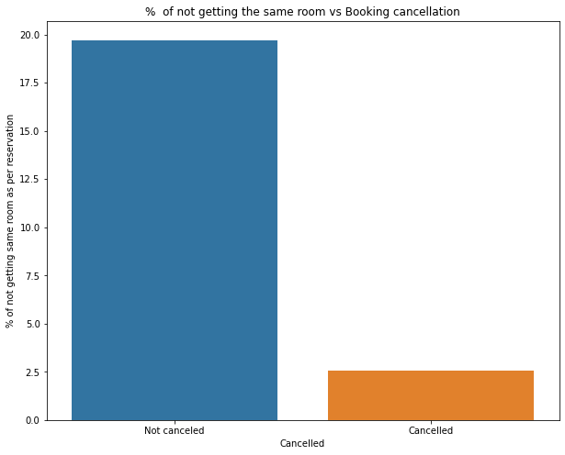
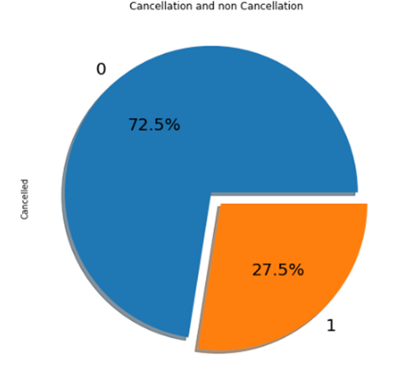
Exploratory Data Analysis:
% Total Cancellations & % of not getting the same room Vs Booking cancellation
to Meal & Agent
Conclusions:
27.5 % bookings made were cancelled out of all the bookings
Almost 19 % people did not cancelled their bookings even after not getting the same room which they reserved while booking hotel, while only 2.5 % people cancelled the booking who did not get the room as per reservation. Thus not getting the same room as per reserved room is not the reason for booking cancellations.

Slide 22
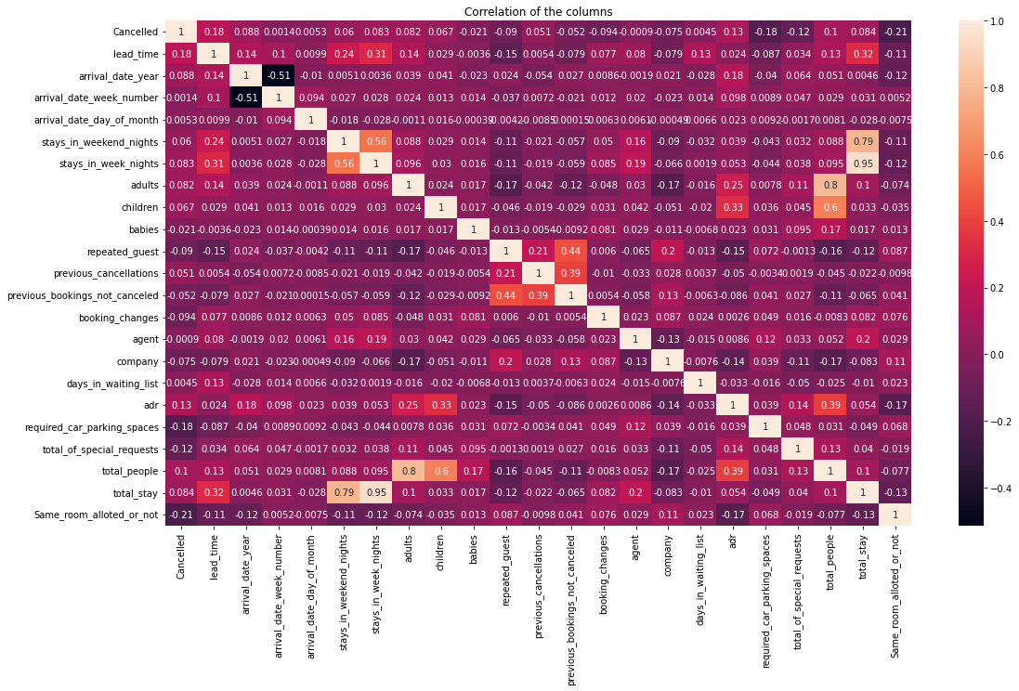
Exploratory Data Analysis:
‘Cancelled’ and ‘same room allotted or not’ are negatively correlated. Not getting the same room as per reserved room is not the reason for booking cancellations.
Lead-time and total stay is positively correlated, which longer the stay of the customer, more will be the lead time.
There is high correlation between ADR and total people, indicating that higher the number of people, more will be the ADR and thus revenue.
Repeated guests and previous bookings not cancelled has strong correlation, which means repeated guests are not most likely to cancel their bookings.
Stay in weeknights and total stay has high correlation, indicating that mostly guests come to stay for weeknights.
Required car parking and cancellations are negatively correlated, which indicates that guests who require car parking do not cancel their bookings.
to Meal & Agent

Slide 23
Conclusions:
City hotels are the most preferred hotel type by the guests.
We can say City hotel is the busiest hotel.
27.5 % bookings were got cancelled out of all the bookings.
Only 3.9 % people were revisited the hotels. Rest 96.1 % were new guests. Thus retention rate is low.
The percentage of 0 changes made in the booking was more than 82 %. Percentage of Single changes made was about 10%.
Most of the customers (91.6%) do not require car parking spaces.
79.1 % bookings were made through TA/TO (travel agents/Tour operators).
BB( Bed & Breakfast) is the most preferred type of meal by the guests. Maximum number of guests were from Portugal, i.e. more than 25000 guests.
Average ADR for city hotel is high as compared to resort hotels. These City hotels are generating more revenue than the resort hotels. The ADR was found higher for City Hotel (61.1%) and for resort hotel it was 38.9%.

Slide 24
Conclusions:
Booking cancellation rate is high for City hotels which almost 30 %.
Average lead time for resort hotel is high.
Waiting time period for City hotel is high as compared to resort hotels. That means city hotels are much busier than Resort hotels.
Resort hotels have the most repeated guests.
Optimal stay in both the type hotel is less than 7 days. Usually people stay for a week.
Almost 19 % people did not cancel their bookings even after not getting the same room which they reserved while booking hotel. Only 2.5 % people cancelled the booking.
More than 2500 guests from PRT country booked the hotels, followed by GBR (~10000) and the least guests were from BEL, BRA and NLD.

Slide 25

Thank You!

